Slide 1
Converting ER diagrams to relational schema
Notes:
Logical database design
Process of converting the conceptual model into an equivalent representation in the implementation model (relational/hierarchical/network etc.)
We will focus on the relational model
Relational database design
Convert ER model into relational schema (a specification of the table definitions and their foreign key links)
There are well defined rules for this conversion

Slide 2
Converting Strong entity types
Each entity type becomes a table
Each single-valued attribute becomes a column
Derived attributes are ignored
Composite attributes are represented by components
Multi-valued attributes are represented by a separate table
The key attribute of the entiry type becomes the primary key of the table

Slide 3
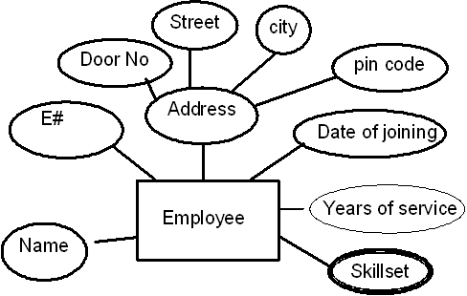
Entity example
Here address is a composite attribute
Years of service is a derived attribute (can be calculated from date of joining and current date)
Skill set is a multi-valued attribute
The relational Schema
Employee (E#, Name, Door_No, Street, City, Pincode, Date_Of_Joining)
Emp_Skillset( E#, Skillset)
Notes:
As per the rules:
Derived attributes are ignored
Composite attributes are represented by components
Multi-valued attributes are represented by a separate table

Slide 4
Entity Example (Contd…)
Employee Table
EmpCode PK
EmpName
DateofJoining
SkillSet
SkillSet
EmpCode FK
Skills

Slide 5
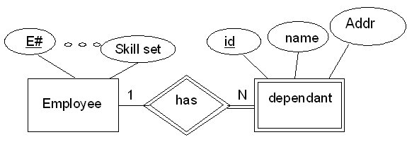
Converting weak entity types
Weak entity types are converted into a table of their own, with the primary key of the strong entity acting as a foreign key in the table
This foreign key along with the key of the weak entity form the composite primary key of this table
The Relational Schema
Employee (E# ,…….)
Dependant (Employee, Dependant_ID, Name, Address)
Notes:
Here dependant is a weak entity. Dependant doesn’t mean anything to the problem without the information on for which employee the person is a dependant.

Slide 6
Converting weak entity types (Contd…)
Employee Table
EmpCode PK
EmpName
DateofJoining
SkillSet
Dependent
EmpCode PK /FK
Dependent_ID PK
Name
Address

Slide 7
Converting relationships
The way relationships are represented depends on the cardinality and the degree of the relationship
The possible cardinalities are:
    1:1, 1:M, N:M
The degrees are:
      Unary
      Binary
      Ternary …

Slide 8
Binary 1:1
1
Manages
1
Employee
department
partial
Total
Case 1: Combination of participation types
  The primary key of the partial participant will become the foreign key of the total participant
  Employee( E#, Name,…)
  Department (Dept#, Name…,MgrE#)

Slide 9
Binary 1 : 1
Employee Table
EmpCode PK
EmpName
DateofJoining
SkillSet
Department
DeptCode PK
DeptName
Location
MgrEmpCode FK

Slide 10
Binary 1:1
Employee
Sits_on
CHAIR
Case 2: Uniform participation types
The primary key of either of the participants can become a foreign key in the other
  Employee (E#,name…)
  Chair( item#, model, location, used_by)
(or)
  Employee ( E#, Name….Sits_on)
  Chair (item#,….)

Slide 11
Binary 1 : 1
Employee Table
EmpCode PK
EmpName
DateofJoining
SkillSet
Chair
ItemNo PK
Model
Location
Used_By FK
Employee Table
EmpCode PK
EmpName
DateofJoining
SkillSet
Sits_On FK
Chair
ItemNo PK
Model
Location

Slide 12
Binary 1:N
1
N
Teacher
teaches
Subject
The primary key of the relation on the “1” side of the relationship becomes a foreign key in the relation on the “N” side
  Teacher (ID, Name, Telephone, ...)
  Subject (Code, Name, ..., Teacher)

Slide 13
Binary 1 : N
Teacher
TeacherID PK
Name
Telephone
Cabin
Subject
SubCode PK
SubName
Duration
TeacherID FK

Slide 14
Binary M:N
N
M
Enrolls
Student
Course
A new table is created to represent the relationship
Contains two foreign keys - one from each of the participants in the relationship
The primary key of the new table is the combination of the two foreign keys
  Student (Sid#,Title…) Course(C#,CName,…)
  Enrolls (Sid#, C#)

Slide 15
Binary M : N
Course
CourseID PK
Coursename
Enrolls
StudentCode PK / FK
CourseID PK / FK
DOIssue
Status
Student
StudentID PK
StudentName
DOB
Address

Slide 16
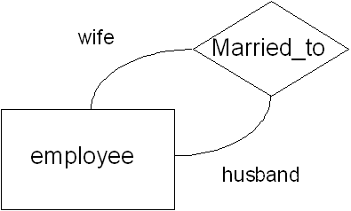
Self referencing 1:1
Consider employees who are also a
couple
The primary key field itself will become
foreign key in the same table
  Employee( E#, Name,... Spouse)

Slide 17
Self referencing 1 : 1
Employee Table
EmpCode PK
EmpName
DateofJoining
SkillSet
Spouse FK

Slide 18
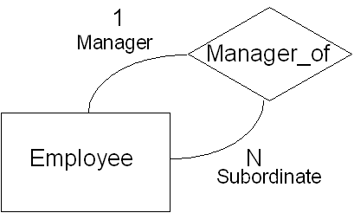
Self referencing 1:N
The primary key field itself will
become foreign key in the
same table
Same as unary 1:1
  Employee( E#, Name,…,Manager)

Slide 19
Self referencing 1 : N
Employee Table
EmpCode PK
EmpName
DateofJoining
SkillSet
Manager FK

Slide 20
Self referencing M:N
Guarantor_of
M
Employee
N
There will be two resulting tables. One to represent the entity and another to represent the M:N relationship as follows
  Employee( E#, Name,…)
  Guaranty( Guarantor, beneficiary)

Slide 21
Self referncing M : N
Employee Table
EmpCode PK
EmpName
DateofJoining
SkillSet
Guaranty
Guarantor PK/FK
Beneficiary PK /FK

Slide 22
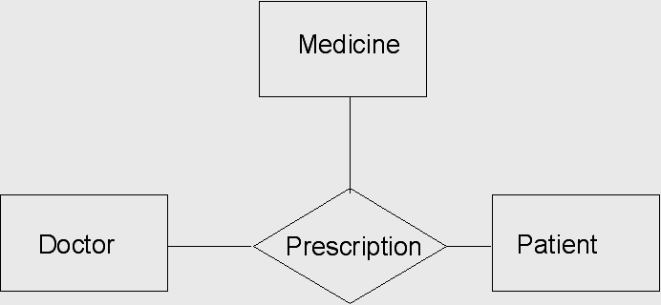
Ternary relationship
Represented by a new table
The new table contains three foreign keys - one from each of the participating Entities
The primary key of the new table is the combination of all three foreign keys
Prescription (Doctor#, Patient #, Medicine_Name)

Slide 23
Ternary
Prescription
DocID PK / FK
PatCode PK / FK
MedName PK/ FK
NextVisit
Doctor
DocID PK
Title
Patient
PatCode PK
PatName
DOB
Address
Medicine
MedName PK
ExpDate

